Slide 1

Machine learning technology for correcting electronic medical texts in Russian
Student: Dmitry Pogrebnoy, J41332c
Supervisor: Sergey Kovalchuk, PhD

Slide 2
Electronic medical records
In healthcare, there are various predictive and decision-making models based on information from patients' medical records
The quality of such models strongly depend on the quality of the source texts
Electronic patient data is usually presented in plain text and contains a lot of spelling errors
Spelling errors in the source texts greatly reduce the quality of the final models and therefore require correction
2/12

Slide 3

Goal and tasks
Goal: Design a method and implement an automatic spelling correction tool for clinical texts in Russian.
Tasks for third semester:
Collect and prepare data for training language models
Select and fine-tune BERT models for ranking task
Conduct extensive testing of the developed tool
Assemble the tool into a package and publish it
3/12

Slide 4
Anamneses dataset
Public datasets
RuMedNLI: A Russian Natural Dataset For The Clinical Domain
RuMedPrimeData
Private datasets
Almazov National Medical Research Center
Research Institute of the Russian Academy of Sciences
All datasets were pre-processed and assembled into final one
4/12

Slide 5
Fine-tune BERT models
sberbank-ai/ruRoberta-large -> MedRuRobertaLarge
Size – 1.4 Gb
distilbert-base-multilang-cased -> MedDistilBertBaseRuCased
Converted from multilang to Russian model
Size - 217 Mb
cointegrated/rubert-tiny2 -> MedRuBertTiny2
Size – 117 Mb
All models are published on the Hugging Face repository
6/12

Slide 6
Single word test
Tool | Error precision | Lexical precision | Overall precision | Average words per second
Aspell-python | 0.86 | 0.859 | 0.859 | 283.7
PyHunspell | 0.812 | 0.539 | 0.675 | 9.4
PyEnchant | 0.829 | 0.541 | 0.685 | 20
LanguageTool-python | 0.762 | 0.904 | 0.833 | 25.1
PySpellChecker | 0.354 | 0.86 | 0.607 | 3.4
SymspellPy | 0.399 | 0.813 | 0.606 | 9702.8
Jumspell | 0.267 | 0.947 | 0.607 | 2552.1
Tool (CPU, MedDistilBert) | 0.701 | 0.981 | 0.841 | 12.7
Tool (GPU, MedDistilBert) |  |  |  | 39.7
7/12

Slide 7
Context word test
Tool | Error precision | Lexical precision | Overall precision | Average words per second
Aspell-python | 0.739 | 0.93 | 0.835 | 357.3
PyHunspell | 0.706 | 0.719 | 0.713 | 11.8
PyEnchant | 0.721 | 0.719 | 0.72 | 24.3
LanguageTool-python | 0.727 | 0.942 | 0.835 | 43.6
PySpellChecker | 0.304 | 0.868 | 0.586 | 6.7
SymspellPy | 0.37 | 0.913 | 0.642 | 26060.2
Jumspell | 0.307 | 0.969 | 0.638 | 4322.3
Tool (CPU, MedDistilBert) | 0.734 | 0.984 | 0.861 | 45.47
Tool (GPU, MedDistilBert) |  |  |  | 134.453
8/12

Slide 8
Python package
Assembled the pip python package
Package contains
Source code
Dictionary with correct words
No models included
Models are loaded dynamically as needed
Published package name - medspellchecker
9/12

Slide 9
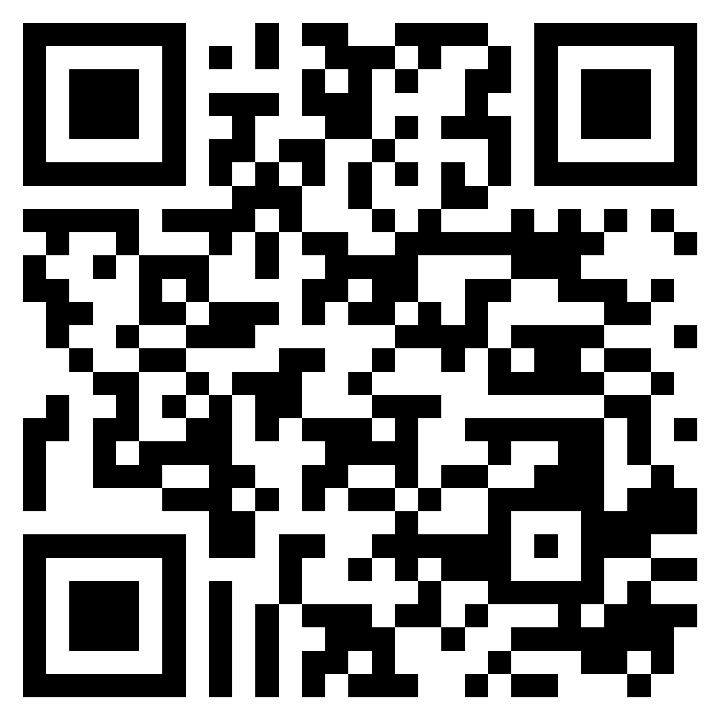
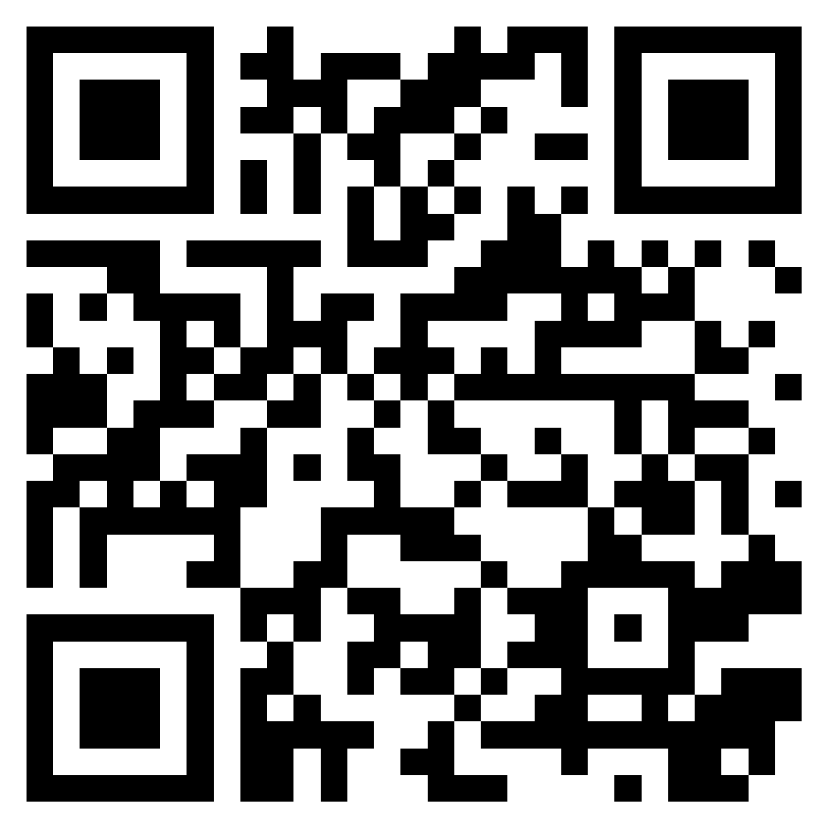
Conclusion
Dataset for training language models is collected
Three different BERT models are fine-tuned for ranking task
Extensive testing of the developed tool is conducted
Package with new tool is assembled
Fine-tuned models
Pip package
10/12

Slide 10
Further plans
Improve and optimize the spelling correction process
Try to fine-tune smaller language models and test them
Evaluate the effect of the developed tool on medical models
11/12

Slide 11

Thank you for your attention!
www.ifmo.ru

Slide 12
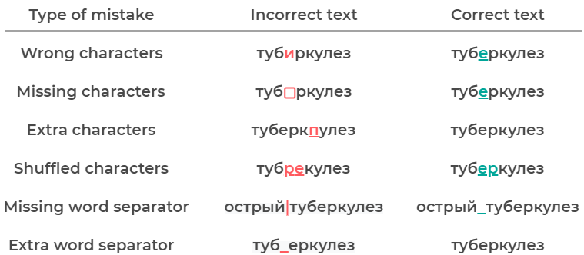
Spelling errors in question
13/12

Slide 13
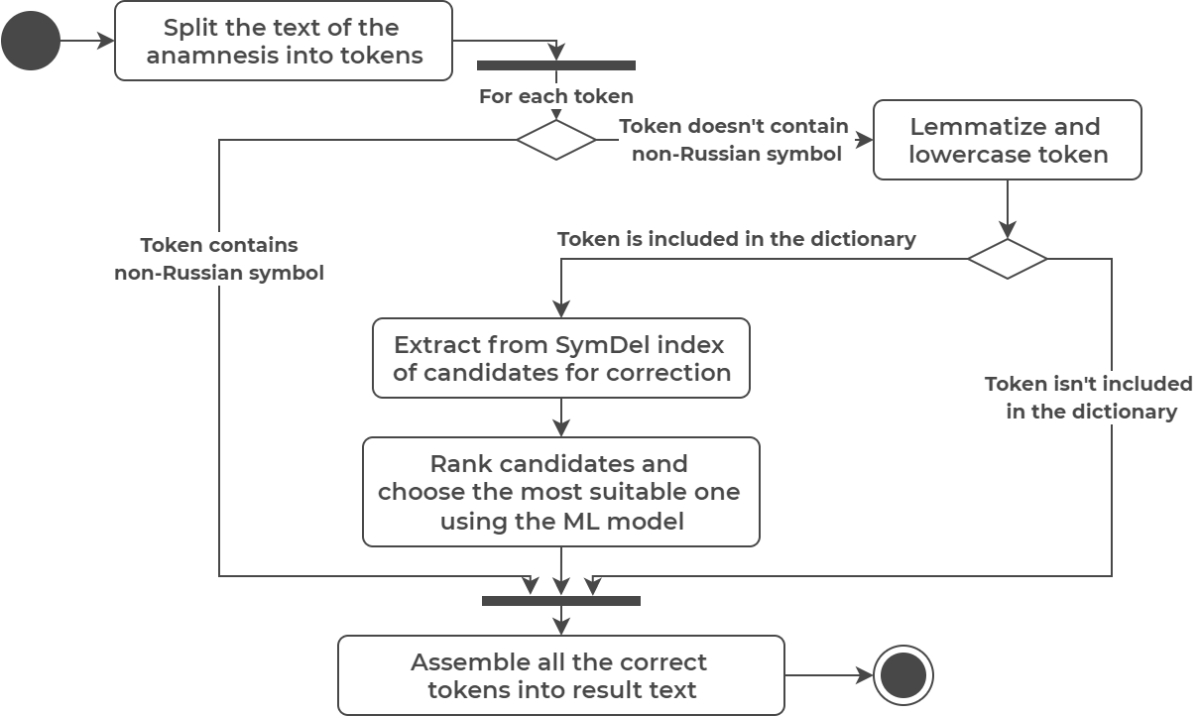
Spelling correction process
5/12

Slide 14
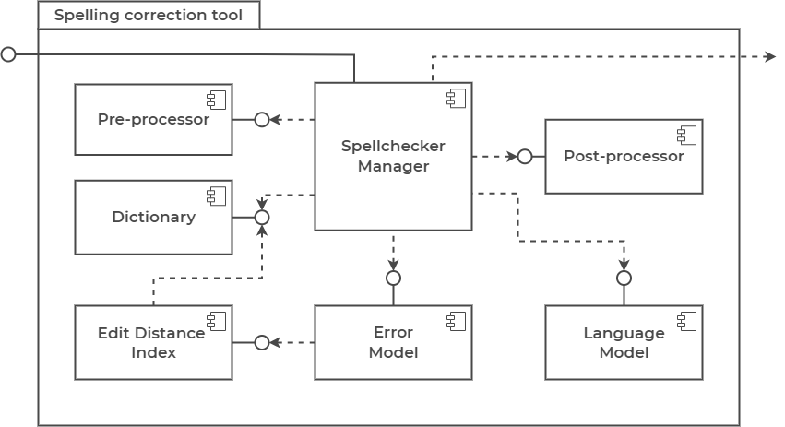
Tool architecture
14/12

Slide 15
Single word test internals
Error precision - the ratio of the number of correctly corrected words to the total number of incorrect words
200 medical words with spelling errors were taken to compute error precision
Lexical precision - the ratio of the number of unchanged modified words to the total number of correct words
200 correct medical words were taken to compute lexical precision
The performance test was done on a laptop on Ubuntu 20.04 with 24 GB RAM and Intel Core i5-10750H CPU @ 1.60GHz * 12
15/12

Slide 16
Context word test internals
Error and lexical precision
100 test samples per each error type
10 words in each sample
One of ten words is incorrect, other words are correct
The performance test was done on a laptop on Ubuntu 20.04 with 24 GB RAM and Intel Core i5-10750H CPU @ 1.60GHz * 12
16/12

